Slide 1



Attacking GraphQL APIs
Ali Jujara
Security Consultant @ Varutra Consulting
@alijujara7

Slide 2

Agenda
What is GraphQL
Advantages of using GraphQL
Working of REST API
Working of a GraphQL API
GraphQL Terminologies
Exploitation
HackerOne Reports

Slide 3

What is GraphQL ?
GraphQL is an API
GraphQL, unlike REST API, uses a single endpoint for all the CRUD operations
Example of a REST API
GET /employee/1
GET /employee
POST /employee/1
Notes:
API
Single Endpoint

Slide 4
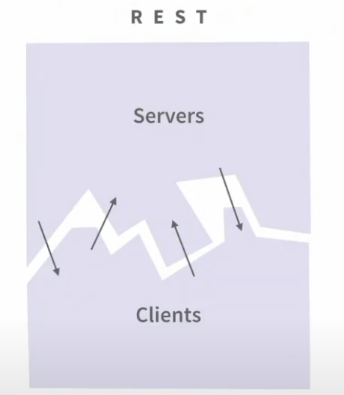
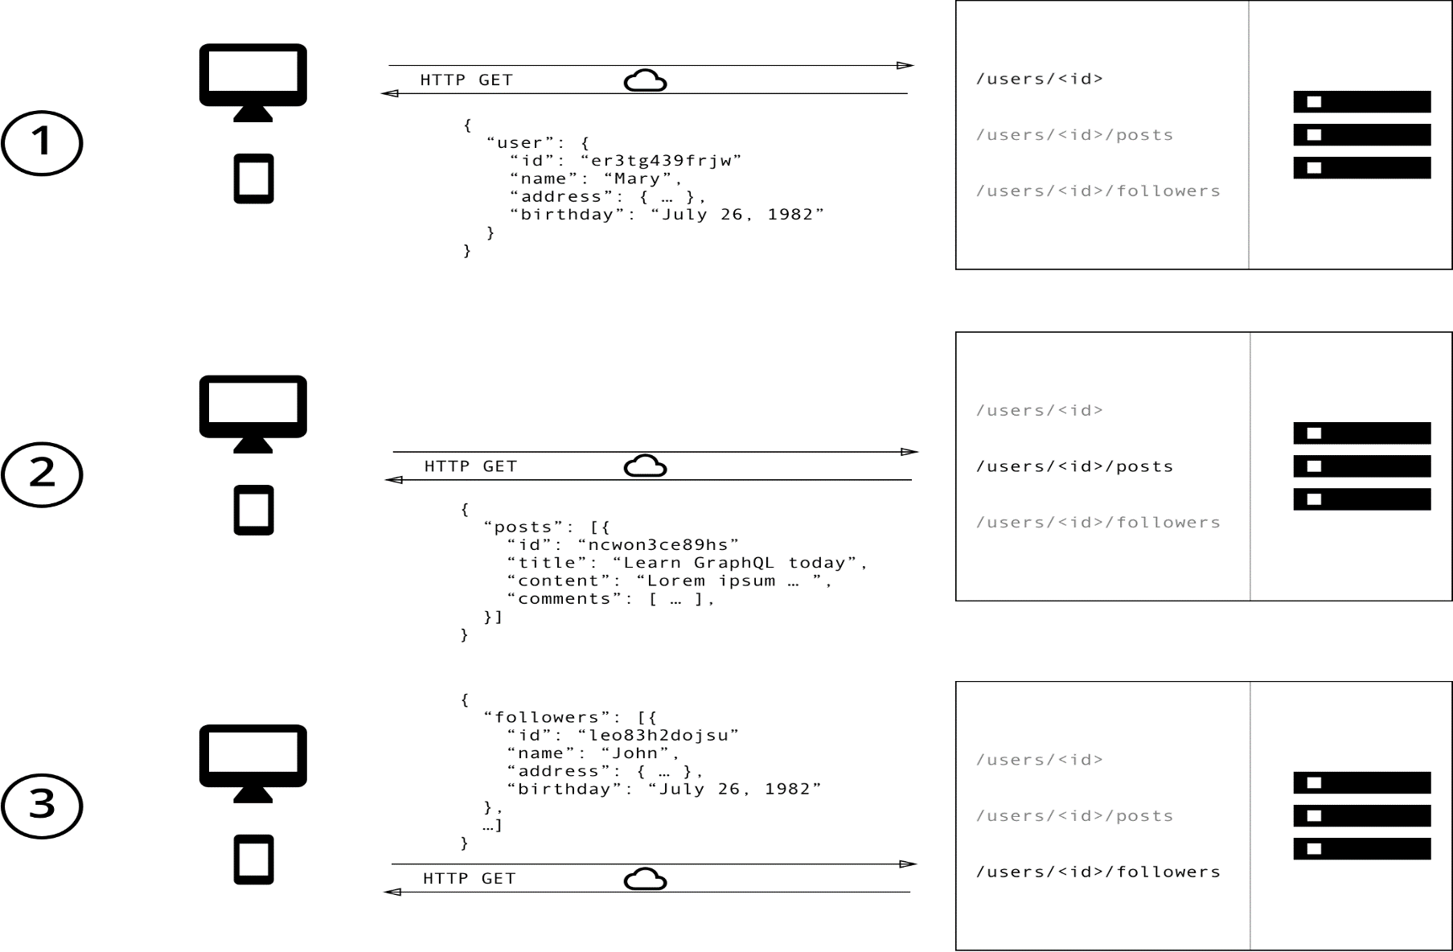
Working of a REST API
Notes:
Lots of Endpoints
Client has no metadata
Example user/info

Slide 5
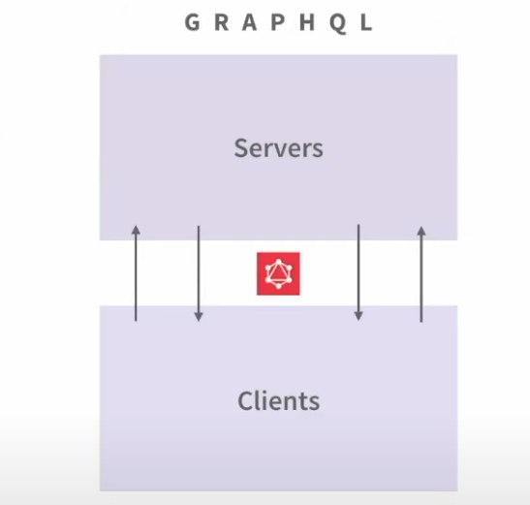
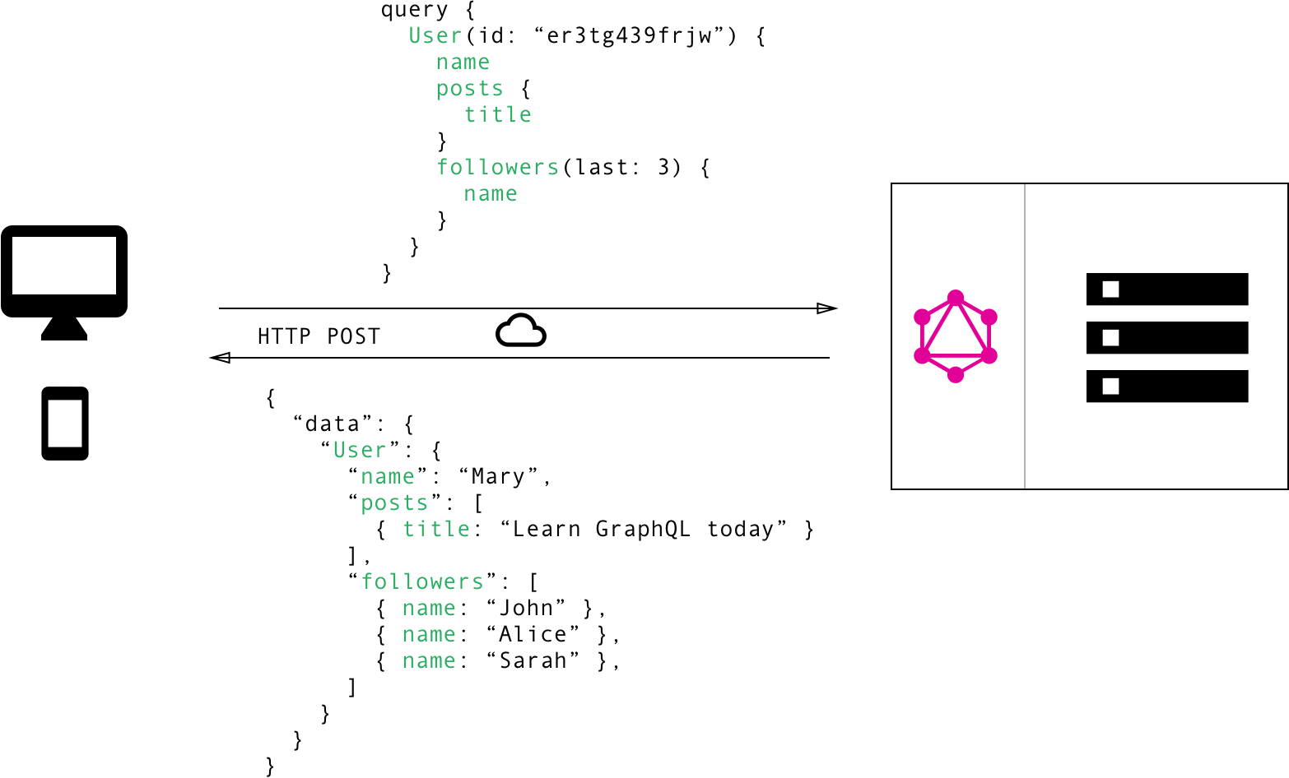
Working of a GraphQL API
Notes:
Observe the single endpoint here

Slide 6
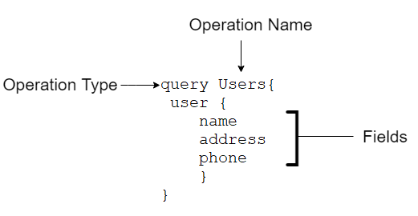
Structure of GraphQL Query

Slide 7
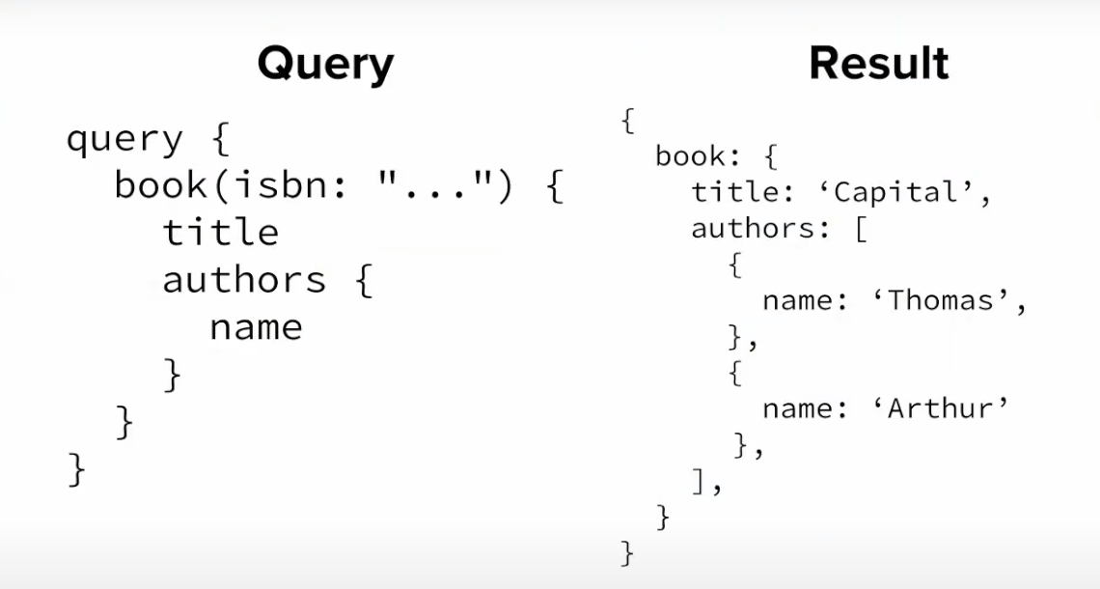

Slide 8
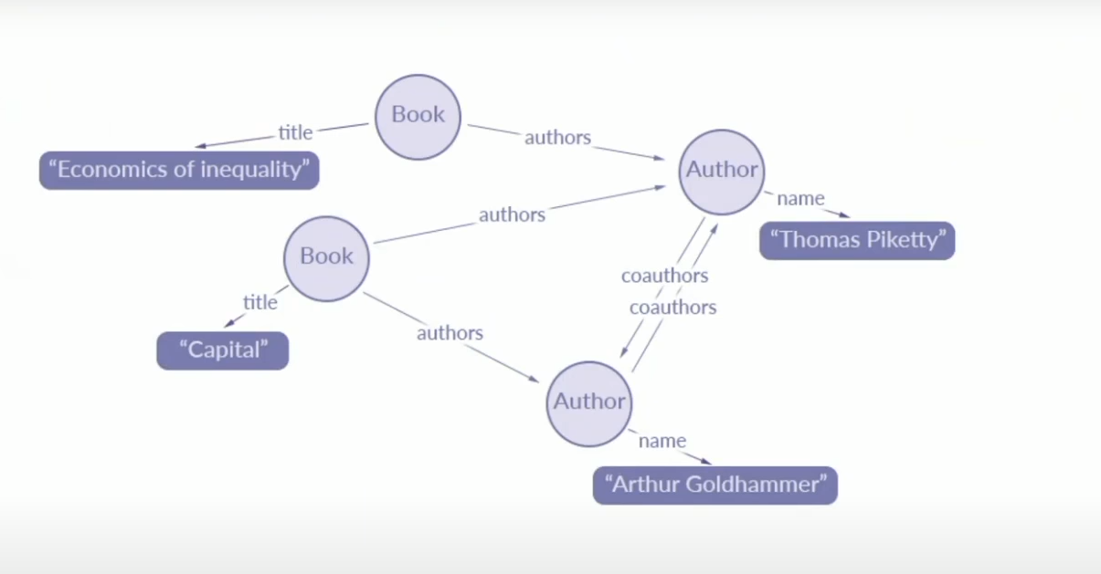
Notes:
Explain Edges vs nodes

Slide 9
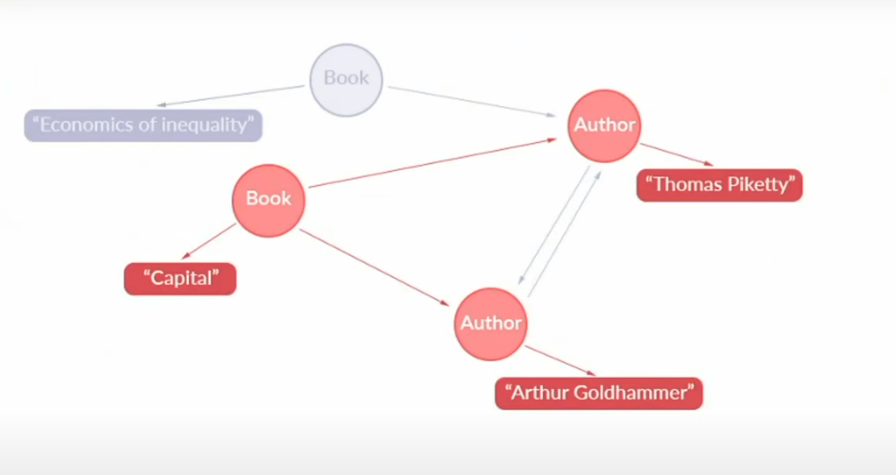

Slide 10
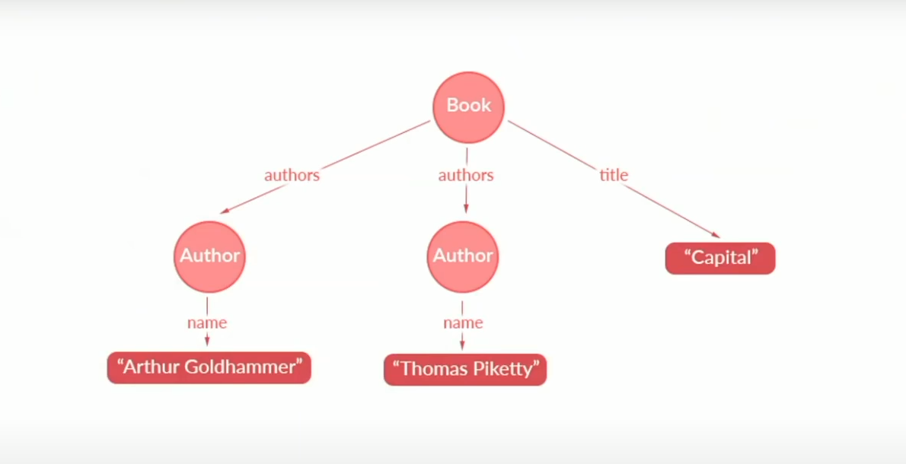

Slide 11
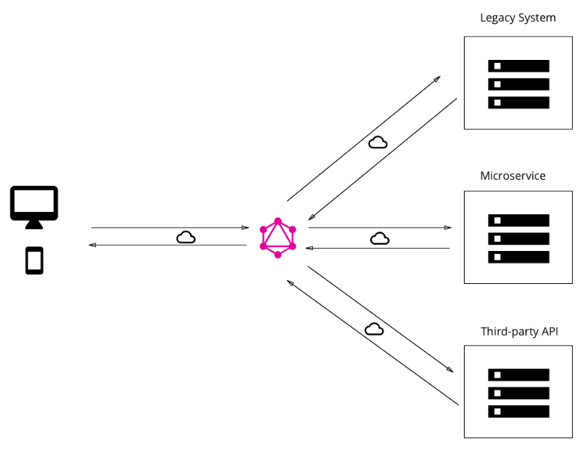
Advantages of GraphQL
Good fit for complex systems and microservices
This makes things easy and quicker (by caching) on the development side
Same endpoint can be used for multiple CRUD operations by writing queries for common operations

Slide 12
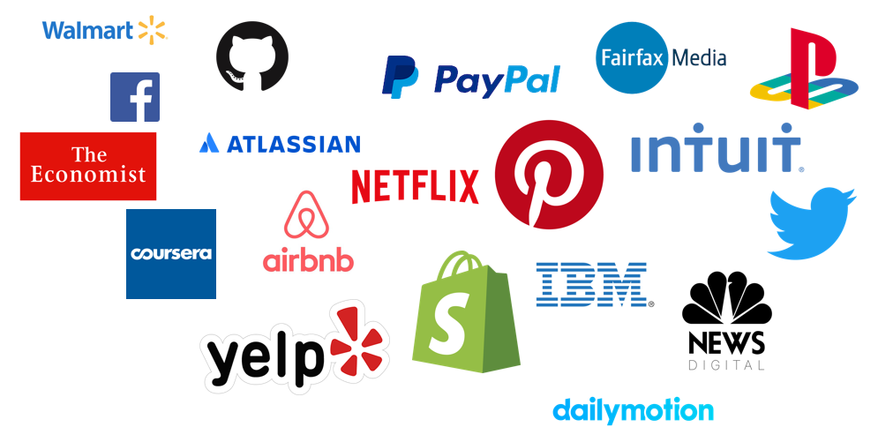
Organizations using GraphQL

Slide 13
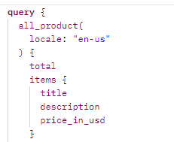
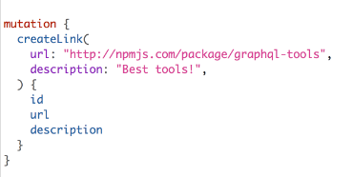
GraphQL Terminologies & Working
Introspection – Used for asking a GraphQL schema for information about what queries it supports
Queries – Used for fetching data
Mutations – Allows for editing data
Fragments – is a piece of logic that can be shared between multiple queries and mutations

Slide 14
GraphQL Introspection
Introspection is the ability to query which resources are available in the current API schema. Given the API, via introspection, we can see the queries, types, fields, and directives it supports
The introspection system defines __schema, __type, __field, __TypeName which are introspective queries

Slide 15
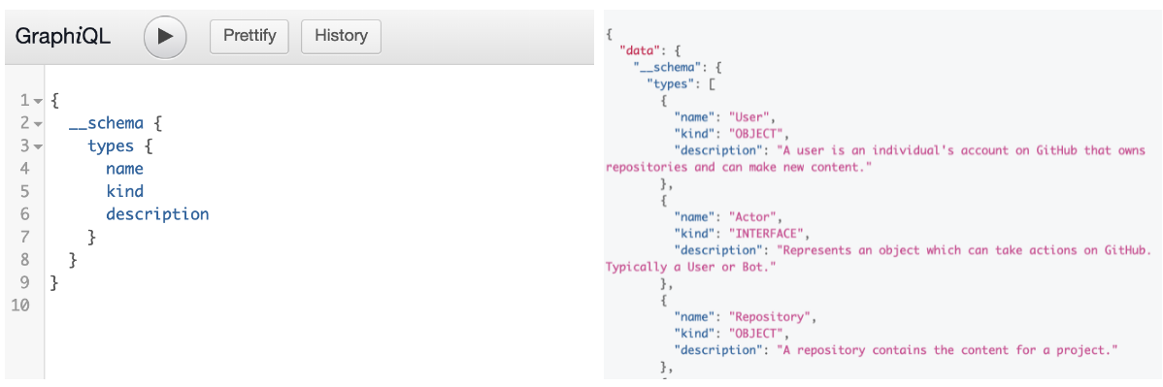
__schema

Slide 16
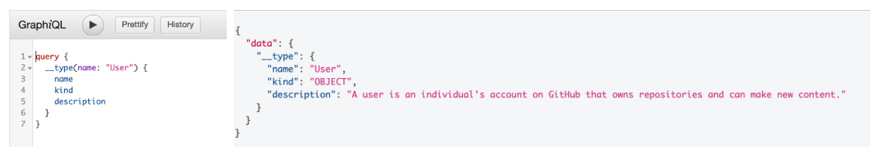
__type
It represents the types defined in the system. We can query the type of an object and get its information.

Slide 17
Exploiting GraphQL
GraphQL interface protection bypass
Information Disclosure on GraphQL Field suggestions
Stored XSS
Arbitrary File Write/Path Traversal
OS Command Injection
Server Side Request Forgery (SSRF)

Slide 18
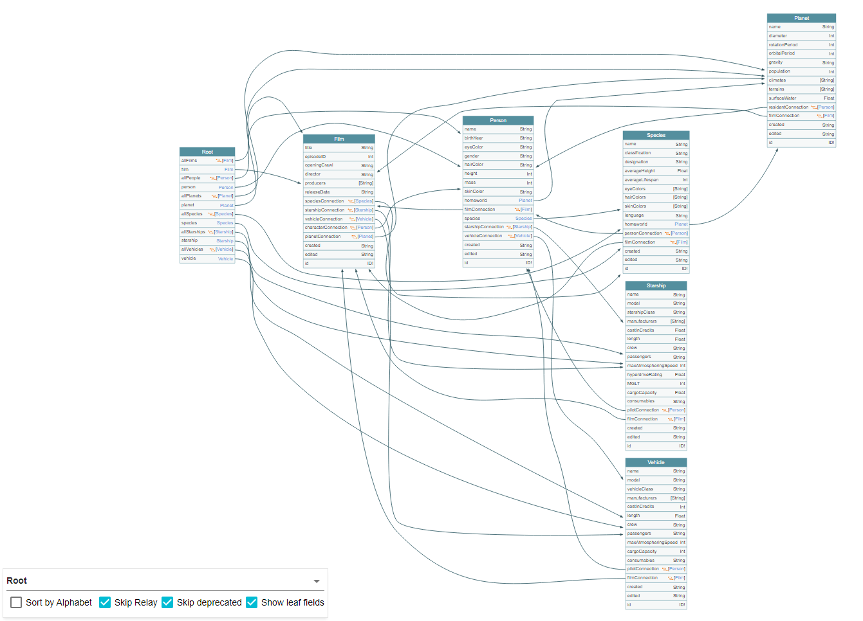
Tools
InQL Scanner
GraphQL Raider
GraphQL Voyager

Slide 19

HackerOne Reports
https://hackerone.com/reports/960244 | - 5000$
https://hackerone.com/reports/707433 | - 2500$
https://hackerone.com/reports/980511 | - 1500$
https://hackerone.com/reports/419883 | - 802.20$
https://hackerone.com/reports/357485 | - 500$

Slide 20
Thank You for your time!!!

